Slide 1
MTG Deck Starter
Presented by Shweta Chandramouli and Abhinandan Patni

Slide 2
OUTLINE
Introduction
Related Work
Our Work
Impact of this project
Conclusion and Future work

Slide 3
INTRODUCTION
What is MTG?
Most popular trading card game
Started in 1993, has 20 million players today.
What are some of the problems players face?
What colors?
What strategy?
Where does Machine Learning come in?

Slide 4
PROBLEM STATEMENT
To create a system that suggests deck color(s) for players wishing to utilize certain mechanics of the MTG game for a new deck.

Slide 5
Related Work
The AI that learned Magic The Gathering.
AI bot that auto generated valid MTG cards using previous knowledge of officially distributed cards.
Magic The Gathering Deck Performance Prediction.
K-means clustering was used to classify decks.
Scores from 1 to 1000 were given to decks, depending on how well the decks would fare in professional tournaments.

Slide 6
OUR WORK
Gather data
Pre-process the data
Based on the correlation between rules and colors, do a preliminary exploration of data
Use classification techniques and compare the results
Design a small web portal to test classification

Slide 7
GATHERING DATA
Explored different data sets that we found.
Chose one dataset with good JSON structure.
Scraped the official database of MTG.
Standardized all the data points to make them consistent and follow a certain format.

Slide 8
PREPROCESSED DATA
{
"name" : "Sen Triplets”,
"manaCost" : "{2}{W}{U}{B}”,
"cmc" : 5,
"colors" : ["White", "Blue", "Black"],
"supertypes" : ["Legendary"],
"types" : ["Artifact", "Creature"],
"subtypes" : ["Human", "Wizard"],
"rarity" : "Mythic Rare”,
"text" : "At the beginning of your upkeep, choose target opponent. This turn, that player can't cast spells or activate abilities and plays with his or her hand revealed. You may play cards from that player's hand this turn.”,
"power" : "3”,
"toughness" : "3”,
"multiverseid" : 180607
}

Slide 9
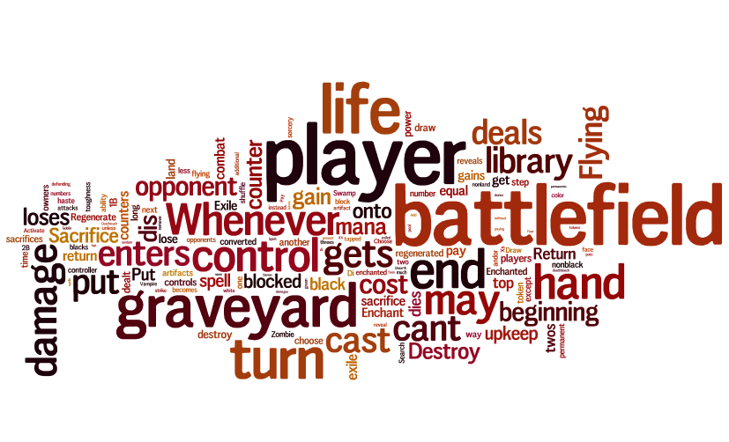
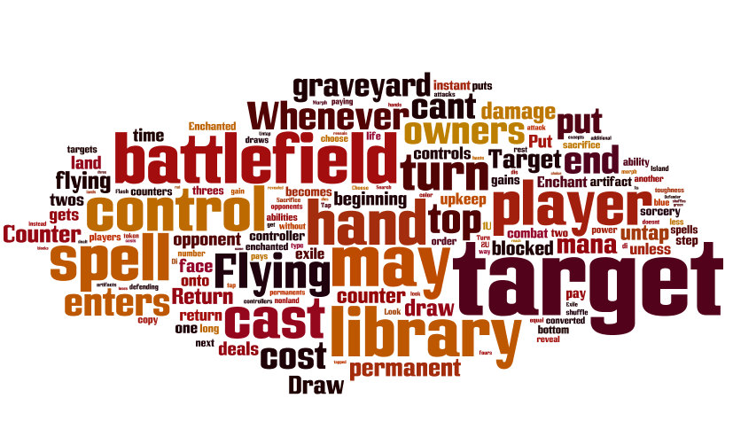
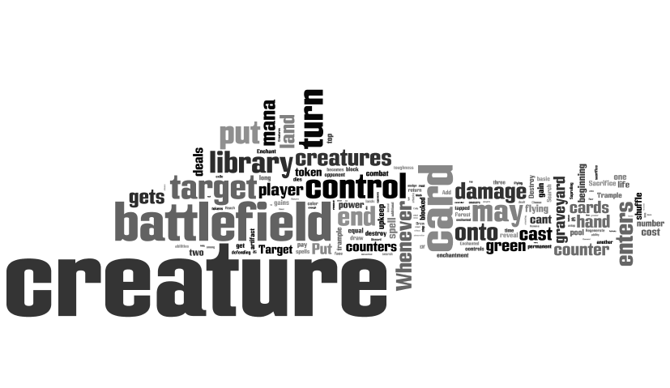
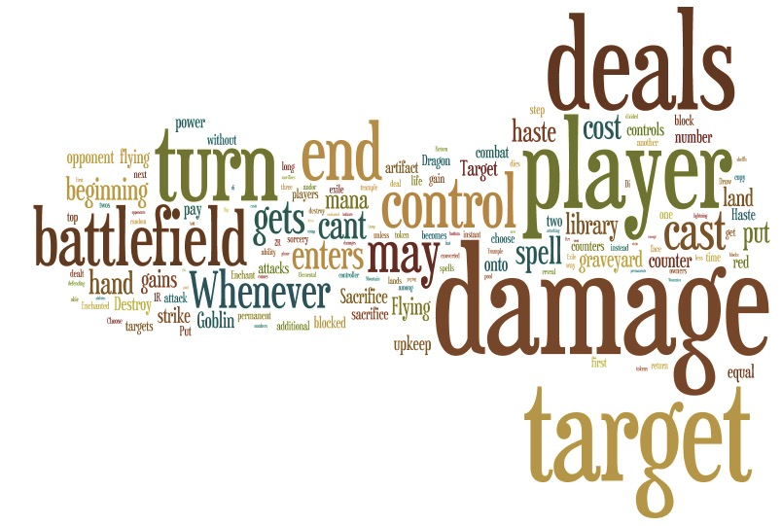
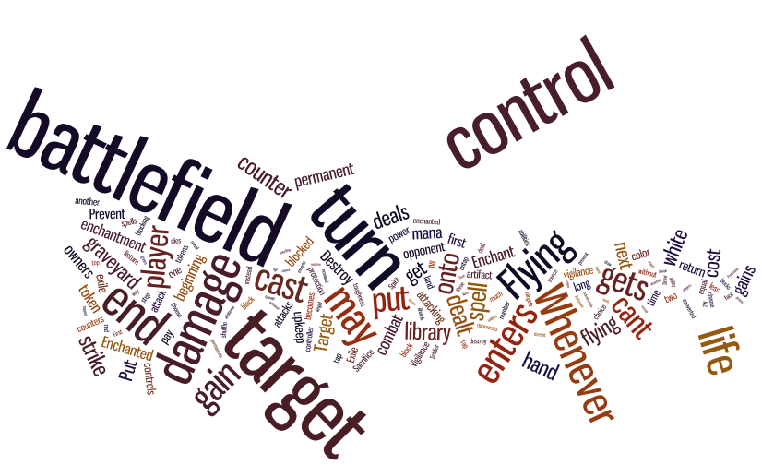
Preliminary Exploration of Data

Slide 10
CLASSIFICATION
After surveying some text classification techniques, we decided to use variations of 2 classification algorithms.
Naïve Bayes:
With / Without text injection, with / without TF-IDF
Support Vector Machines:
Linear
RBF
Polynomial
Sigmoid

Slide 11
NAÏVE BAYES
Initial version included only word counts. Involved basic tokenization of text.
Improved version used TF-IDF as the measure for feature extraction.
Based on preliminary exploration of data, we decided to use word injection from a list of keywords to give higher weightage to more relevant words.
This worked well!

Slide 12
SUPPORT VECTOR MACHINES
Mean absolute error => “Measure of performance”
Used both svm_multiclass and libsvm for this purpose.
Got similar results

Slide 13
RESULTS
From Naïve Bayes, we got accuracies between 64-82%. Considering this is textual data with not so linear components, we were happy.
From SVM, we got accuracies ranging from 46 [linear] to 93% [RBF]. Polynomial [deg3] was 76% and Sigmoid was around 85%.
Best part is, training data and test data were very similar. We actually ended up getting the same accuracies almost consistently.

Slide 14
RESULTS
Finally, what we do is that once you give us the query, we run all these methods in the background and generate a list of colors with confidence scores. We give out the color with the maximum confidence score.
Based on the results from classification, we decided to be more liberal with Naïve Bayes with injection,TF-ID, and SVM with RBF. We gave these confidence scores of 0.3 and 0.3 each. For SVM with Sigmoid, we gave a score of 0.2, and to the remaining, we gave 0.05

Slide 15
CONCLUSION & FUTURE WORK
Based on the rules text, design a recommendation system to predict which cards are the best and have good synergy with similar cards.
Given more constraints, decide which cards are more suited to strategy. This involves detailed study of contraint satisfaction.
Provide an option to build decks and predict their strength for professional tournaments.

Slide 16
THANK YOU!
QUESTIONS?

